Slide 1
Matrix Multiplication

Slide 2
2x2 Matrix Multiplication
C_{1,1}=A_{1,1}B_{1,1}+A_{1,2}B_{2,1}
C_{1,2}=A_{1,1}B_{1,2}+A_{1,2}B_{2,2}
C_{2,1}=A_{2,1}B_{1,1}+A_{2,2}B_{2,1}
C_{2,2}=A_{2,1}B_{1,2}+A_{2,2}B_{2,2}
A_{1,1}
A_{1,2}
B_{1,1}
B_{1,2}
C_{1,1}
C_{1,2}
×
=
A_{2,1}
A_{2,2}
B_{2,1}
B_{2,2}
C_{2,1}
C_{2,2}

Slide 3
Divide and Conquer?
Assume matrices of size 2^{n}×2^{n}
Multiplications: M(n) = 8M(n/2), M(1)=8
Additions: A(n) = 8A(n/2)+n²
M(n) = 8^{lg n} = n^{lg 8} = n³
Additions are also Θ(n³), but point is moot
Can we reduce the 8 multiplications in the base equations

Slide 4
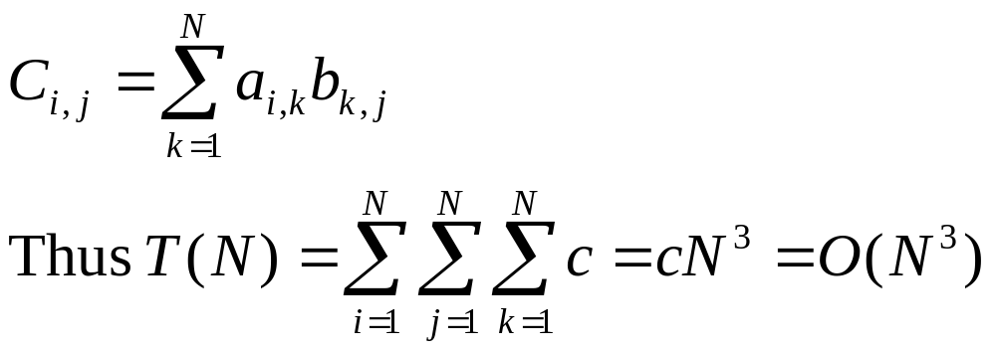
Basic Matrix Multiplication
void matrix_mult (){
for (i = 1; i <= N; i++) {
for (j = 1; j <= N; j++) { compute C_{i,j}; }
}}
algorithm
Time analysis

Slide 5
Divide-and-Conquer
Divide-and conquer is a general algorithm design paradigm:
  Divide: divide the input data S in two or more disjoint subsets S₁, S₂, …
  Recur: solve the subproblems recursively
  Conquer: combine the solutions for S₁, S₂, …, into a solution for S
The base case for the recursion are subproblems of constant size
Analysis can be done using recurrence equations

Slide 6
Divide and Conquer Matrix Multiply
A × B = R
A₀ | A₁
A₂ | A₃
B₀ | B₁
B₂ | B₃
A₀×B₀+A₁×B₂ | A₀×B₁+A₁×B₃
A₂×B₀+A₃×B₂ | A₂×B₁+A₃×B₃
×
=
Divide matrices into sub-matrices: A₀ , A₁, A₂ etc
Use blocked matrix multiply equations
Recursively multiply sub-matrices

Slide 7
Divide and Conquer Matrix Multiply
A × B = R
a₀
b₀
a₀ × b₀
×
=
Terminate recursion with a simple base case

Slide 8

Strassens’s Matrix Multiplication
P₁ = (A₁₁+ A₂₂)*(B₁₁+B₂₂)
P₂ = (A₂₁ + A₂₂) * B₁₁
P₃ = A₁₁ * (B₁₂ - B₂₂)
P₄ = A₂₂ * (B₂₁ - B₁₁)
P₅ = (A₁₁ + A₁₂) * B₂₂
P₆ = (A₂₁ - A₁₁) * (B₁₁ + B₁₂)
P₇ = (A₁₂ - A₂₂) * (B₂₁ + B₂₂)
C₁₁ = P₁ + P₄ - P₅ + P₇
C₁₂ = P₃ + P₅
C₂₁ = P₂ + P₄
C₂₂ = P₁ + P₃ - P₂ + P₆

Slide 9
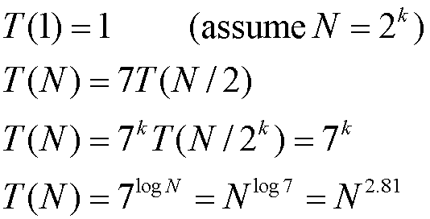
Analysis of Strassen
Only 7 multiplications are used
Will work with matrices, because associative property is not used
Multiplications: M(n) = 7M(n/2), M(1) = 7
Additions: A(n) = 7A(n/2)+18(n²/4)
First algorithm to break the n³ “barrier”

